Slide 1
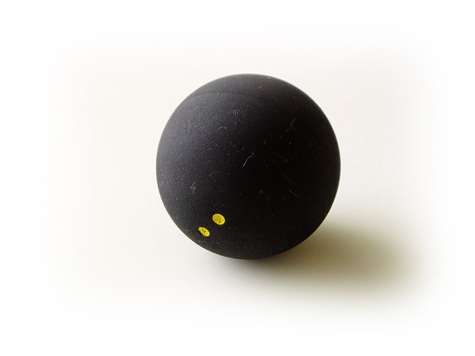
LM1337
ENPH 253 Robot Competition

Slide 2
The Contest
Two autonomous robots face-of on identical sides of an arena.
Using balls located at the rear of the sloped arena surface, the goal is to knock over more of the targets (placed along the center of the arena) than the other robot in 90 seconds.
Available targets emit a 1kHz infrared signal.
The rear of the arena emits a 10kHz infrared signal.

Slide 3
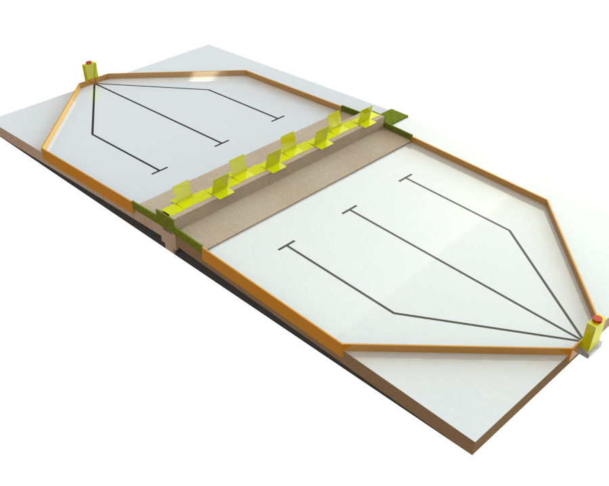
The Arena
Collection area (10kHz IR beacon)
Targets (1kHz IR beacons)
Tape lines

Slide 4
Our Strategy
Collecting and firing on the same (front) side of the robot.
Strafing along the target wall.
Line following to and from the collection area.

Slide 5
A Typical Run
Start at target wall.
Line-follow back to collection.
Collect.
Line-follow to target wall.
Strafe and fire, collecting rebounds.
Repeat when empty.

Slide 6
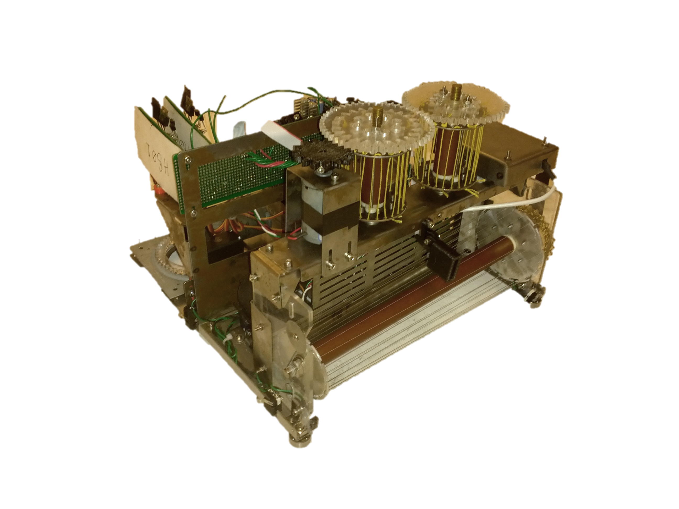
Compact collection and firing mechanism
Brush collects and corrals the balls to one side of the robot.
Balls are lifted one at a time up to the firing mechanism.

Slide 7
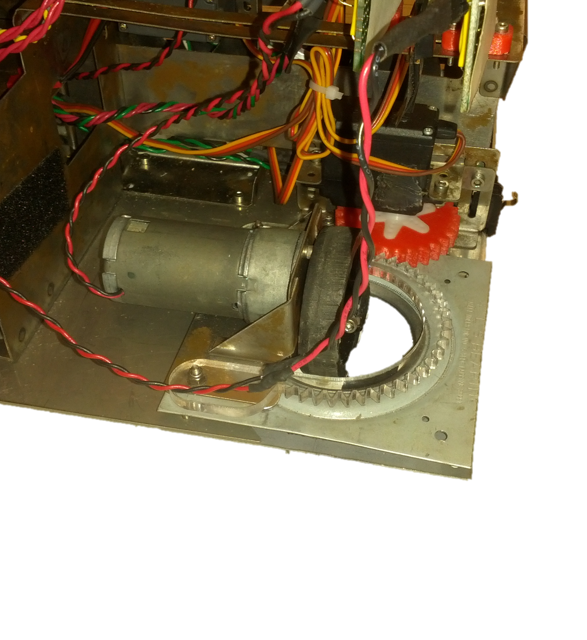
Rotatable rear wheels
Servo-controlled.
Transforms between differential-drive and “bicycle” mode.

Slide 8
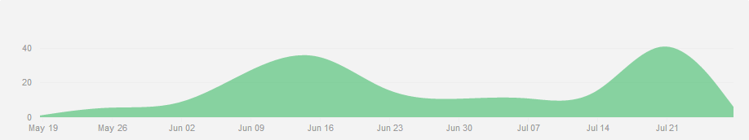
Time Management
Design Proposal
Time Trials
Thermo Labs Due

Slide 9
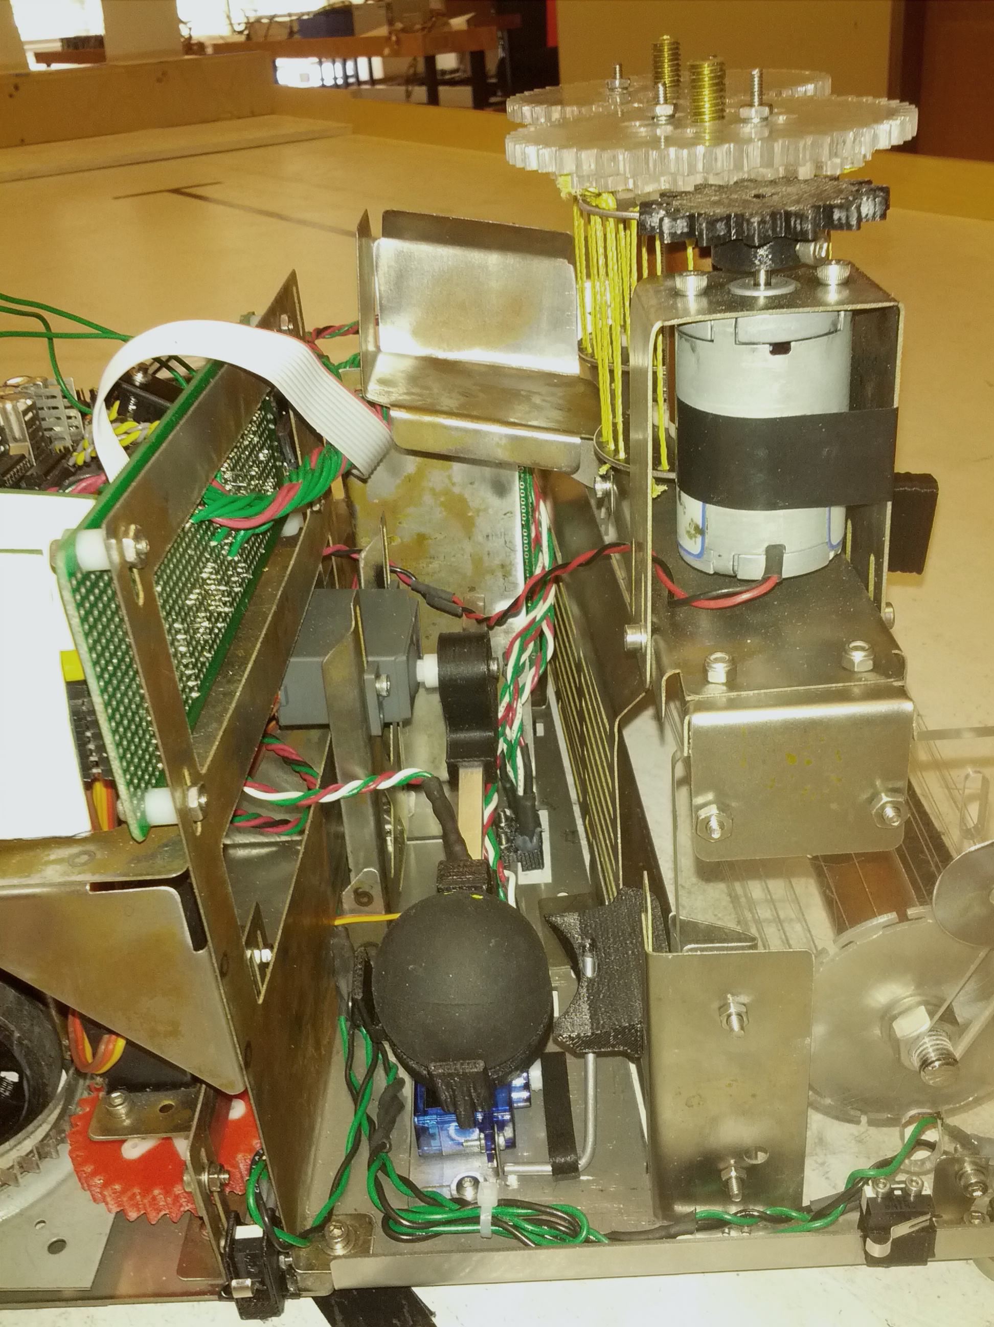
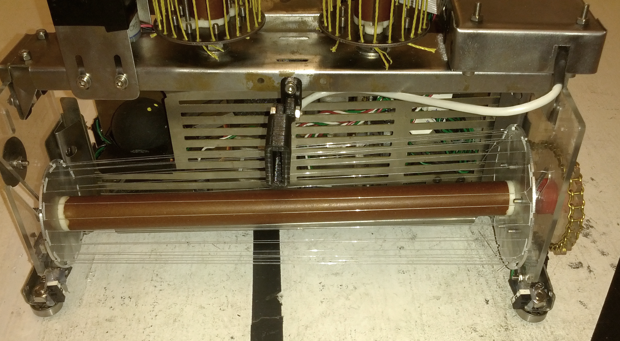
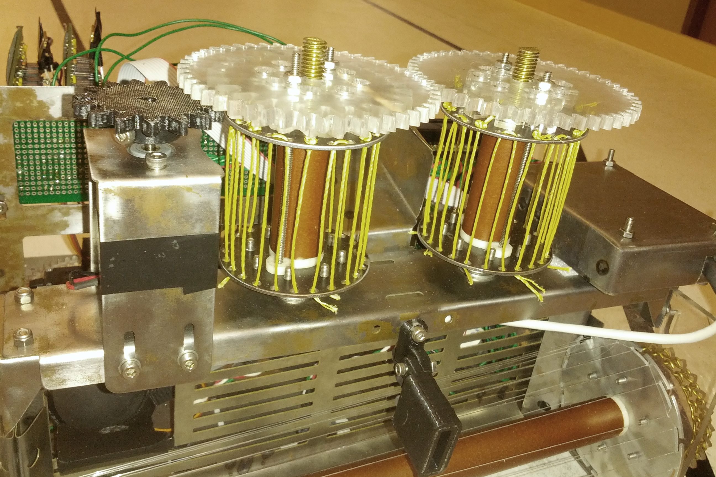
Finished Product

Slide 10
